Slide 1







Success factors - SpaceX
Soonyoul Kwon
Xyz@gmail.com
January 18, 2024

Slide 2



Table of Contents
Executive Summary
Introduction
Methodology
Results
Visualization – Charts
Dashboard
Discussion
Findings & Implications
Conclusion
Appendix

Slide 3

EXECUTIVE SUMMARY
Reusing the rockets is key success factor (KSF) of SpaceX
To increase the cost saving effect, the business should focus its resource more on launching the rockets on the area with higher landing success rate.
Not all features has had meaningful impact to the landing success.
There are some factors that had significant impact on the success rate
CCAFS SLC 40 when the payload mass over 10,000.
The heavier payload mass, LEO, ISS, and PO.
KSC LC-39A has the highest success rate.

Slide 4

INTRODUCTION
SpaceX has become an industry leader based on the comparative cost effectiveness.
This is due to the reusability of the rockets
Thus, the successful landing of them is critical
I would like to discuss some success factors that affected the landing performance.

Slide 5

METHODOLOGY
Data collection and wrangling
Exploratory data analysis with SQL & Interactive map with Folium / Plotly Dash dashboard
Predictive analysis

Slide 6
Data collection & wrangling methodology
Data collected from SpaceX API
Data normalization using .jason_normalize()
Data filtering in pandas DataFrame
Imputing missing data (i.e. mean value for null PayloadMass)
Data scrapping using BeautifulSoup
And Parsing data to dictionary to DataFrame
Exploring datasets using df.methods

Slide 7
EDA and interactive visual analytics methodology
SQL
Loading data from csv
Converting to DataFrame
Execute sql queries using %sql
Folium & Dash
Locate coordinates in map using folium
Calculate the distances between coordinates
Draw lines between coordinates
Creating a layout including dropdown implementation
Adding callback functions using inputs and outputs
Exploratory visualization (plots)
matplotlib
seaborn

Slide 8
Predictive analysis methodology
Split train and test data
For each method (logistic regression, support vector machine, decision tree classifier, and k nearest neighbors)
Create object and fit the object to the train data to get the best parameters and accuracy score
Calculate the accuracy on the test data
Visualize false-positive/negative in confusion matrix

Slide 9
Results
EDA with visualization
EDA with SQL
Interactive map with Folium
plotly Dash dashboard
Predictive analysis (classification)

Slide 10
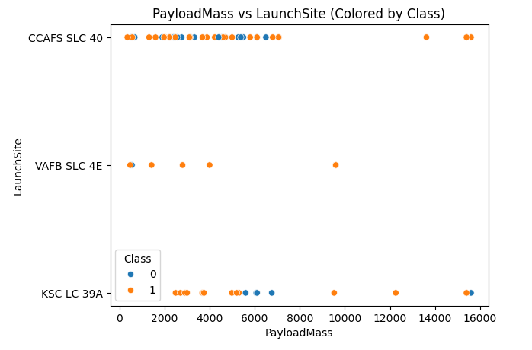
EDA with visualization results
For the launch site CCAFS SLC 40 only, high success rate for the payload mass over 10,000.

Slide 11
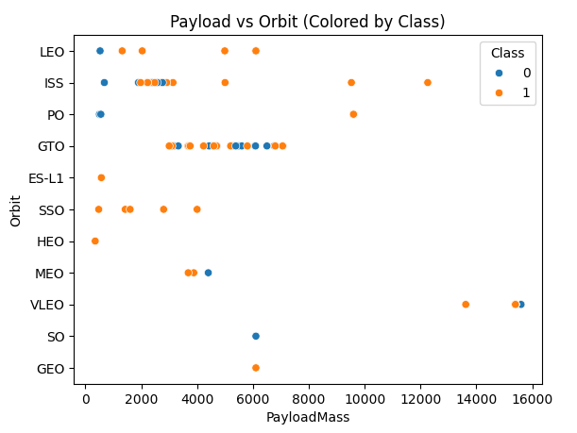
EDA with visualization results
The heavier Payload mass, the higher success rate for the three orbits: LEO, ISS, and PO

Slide 12
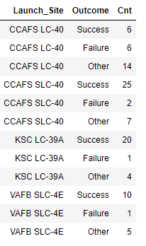
EDA with SQL results
KSC LC-39A has the highest success rate.

Slide 13
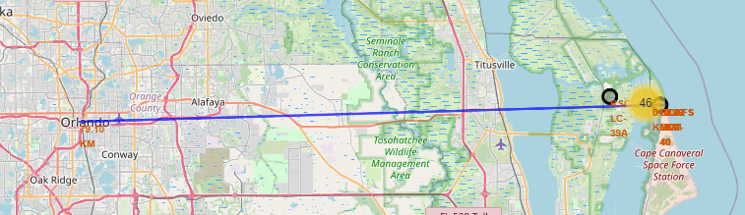
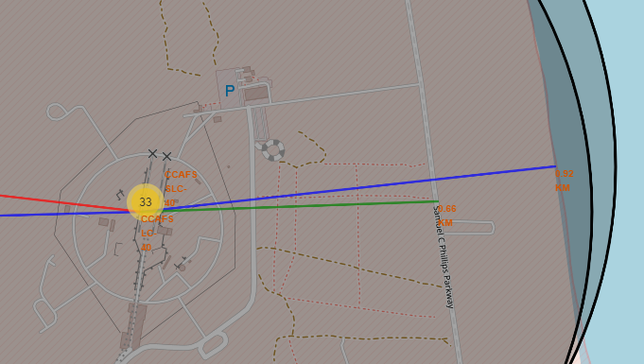
Interactive map with Folium results
Distances from CCAFS LC 40
To the closest shore: 0.92km
To the closest highway: 0.66km
To the closest city (Orlando, FL): 9.10km

Slide 14
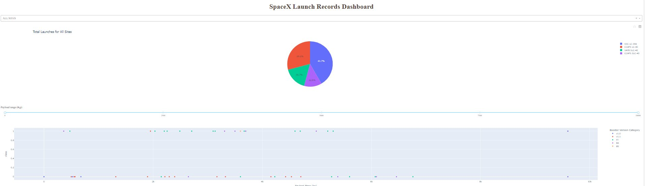
plotly Dash dashboard results

Slide 15
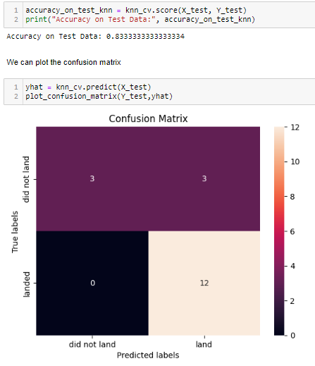
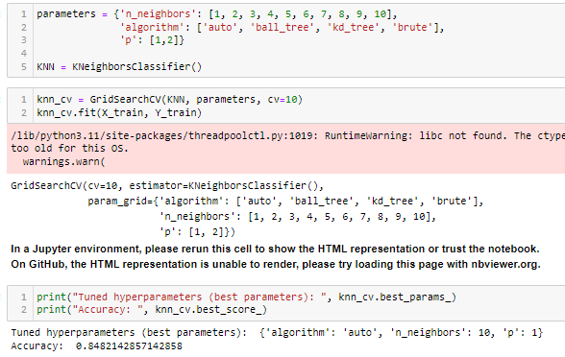
Predictive analysis (classification) results
All models tested had three false-negative but a decision tree classifier had one more false-negative than the other models.
K-nearest neighbors(knn) had the highest accuracy score among all models.

Slide 16
DISCUSSION
Decision-tree classifier
The 'max_features' parameter should be set to an integer, a float, a string ('log2' or 'sqrt'), or None. 'auto' that were taught and provided from the instruction is replaced with None.
Accuracy vs run-time
The accuracy of the model was not noticeably different among the models used.
Decision tree and kNN took more resource and time for fitting the models to the test data than the logistic regression and SVM.
Assuming the quality of dataset stay similar, the trade-off between accuracy and resource consumption should be considered when volume of data is significant.

Slide 17
OVERALL FINDINGS & IMPLICATIONS
Findings
For the launch site CCAFS SLC 40 only, high success rate for the payload mass over 10,000.
The heavier Payload mass, the higher success rate for the three orbits: LEO, ISS, and PO.
KSC LC-39A has the highest success rate.
Put more resources to the combination of the launch site, payload and the orbit that has had higher success rate.

Slide 18

CONCLUSION
Among many factors (features), some were indifferent with respects to the success rate.
However, some had definitely influenced more on the success rate of the landing scenario.
So, the company should focus more on the combination of the success factors by putting more resources to them to increase a chance of reusing the rocket and reduce its cost.

Slide 19
APPENDIX
Rocket launch data from SpaceX API
https://api.spacexdata.com/v4/launches/past
List of Falcon 9 and Falcon Heavy launches Wikipage updated on 9th June 2021
https://en.wikipedia.org/w/index.php?title=List_of_Falcon_9_and_Falcon_Heavy_launches&oldid=1027686922

